Slide 1
UPMC Geographical Reach
10 Counties

Slide 2
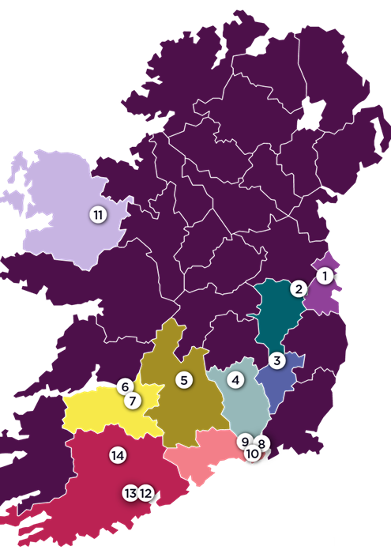
Locations
Cork
Waterford
Kilkenny
Carlow
Kildare
Dublin
Mayo
Galway
Limerick
Tipperary

Slide 3
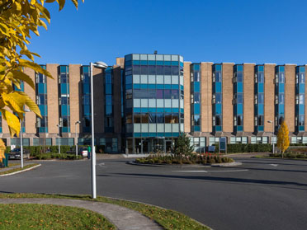
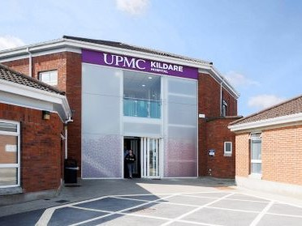
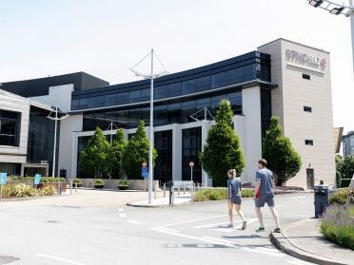
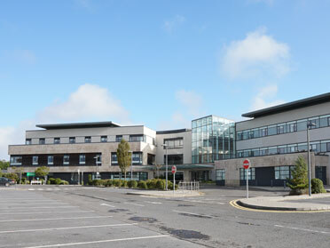
Access to care
4 Hospitals
UPMC SSC Dublin
UPMC Kildare
UPMC Aut Even Kilkenny
UPMC Whitfield Waterford
2 Radiotherapy sites
Waterford
Cork
1 New site coming soon to Limerick
3 Outreach Centres
Carlow
Cork
Dublin
6 Sports Medicine Sites & 1 Institute for Health

Slide 4
Capacity
Beds 325
Theatres 20- 1 new Ortho coming
6 Endoscopy suites
Staff 1,800 in Ireland
200+ Consultants

Slide 5
YPMC Health Checks
Optimise your Health's longevity

Slide 6
Health screen Checks
Heart Check
BP, Pulse
ECG
GP Cardiac Exam
Q-Risk Score
Pre- Appointment
Health & Lifestyle Assessment Form
Lung Check
Spirometry
Oxygen Saturations
GP Lung Exam
GP lead Clinical examinations
Laboratory Testing
FBC, U&E, LFT, TFT
Lipids, HbA1c, Glu
Iron, B12, Folate, Ca
PSA
Urine Analysis
Report
Personalised Report
Tailored Lifestyle Advice
GP Copy
Referral is required

Slide 7
Feedback
Excellent service from the first phone call all the way to the scone and the coffee after the screening.
The Team were very friendly and put me at ease
Would recommend to friends
Will be back
Very professional service

Slide 8
Why choose UPMC for your Corporate Health check

